Slide 1
WHO AM I?

Slide 2
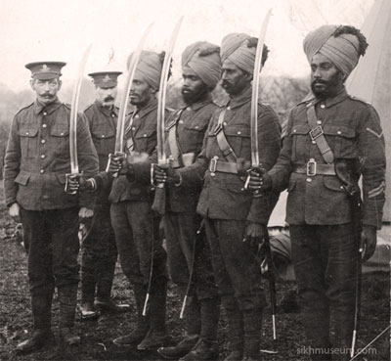

Slide 3
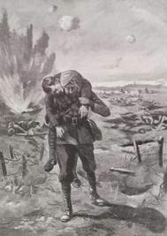

Slide 4
My dear Harbans
Thank you so much for your letter of 27 June.
It was a great pleasure to me to be able to see you and Amarjeet and your two delightful children and to get to know you better than I have ever known you before. When we were at Kalka on 4 June, I did not realize at that time that it was exactly 53 years that very day when your father carried me out of action when I was wounded. What a curious coincidence that was!
Yours ever
R.A.Savory

Slide 5
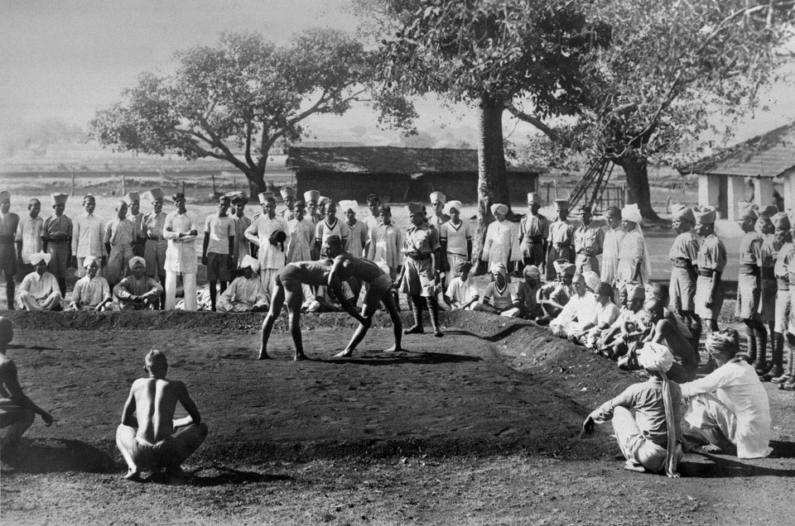

Slide 6
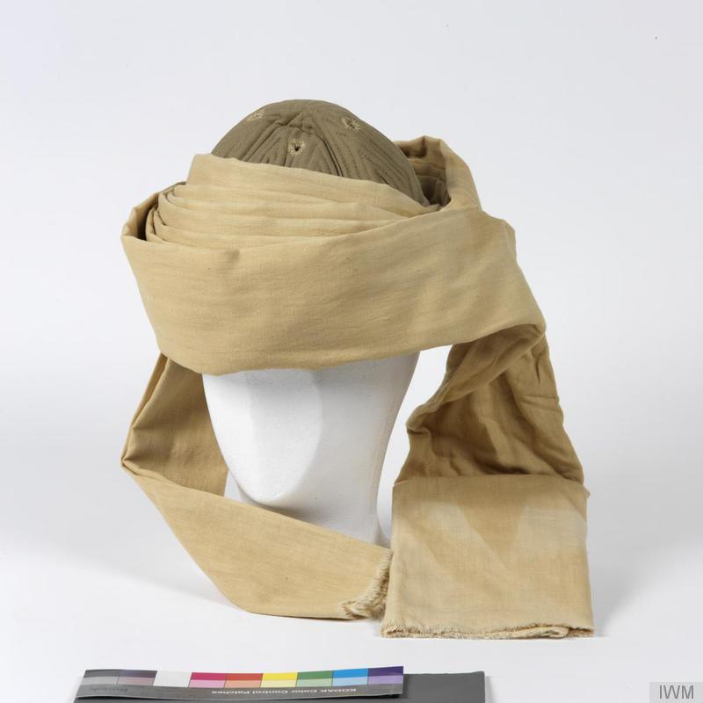
Turban

Slide 7
‘The brave Sikhs, who earned a very high degree of appreciation included Sardar Udai Singh, who had saved the life of 2nd Lt R.A. Savory. The handsome Jat Sikh of Manikwal village (near Gill railway station) was over 6 ft tall and had a fair beard and light green eyes. He was a wrestler from his very childhood and when in 1907 he went to Ferozepur to take part in a wrestling match, he was selected by the British to join the 14th Sikhs.’

Slide 8
Udai Singh was over six feet tall, and had a fair beard and light green eyes. He was recruited in 1907, at Ferozepore, Punjab, after taking part in a wrestling match.The 14th Sikh Regiment were at the extreme left of the British advance at Krithia with their line of advance was covered from every direction by Turkish machine guns.
Casualties were terrible. When Second Lieutenant Savory did not return from the attack, Ude Singh went out to find him and carried him to safety. Savory and one other were the officers of the 14th Sikhs not seriously wounded or killed in the battle. Gallipoli was a bloody battleground, with only 134 of the 574 men of the 14th Sikh Regiment and only two of the 15 British officers of the unit surviving.

Slide 9
After the war Udai Singh and Reginald Savory, who became a general, corresponded throughout their lives.
"My head was bleeding and I was dazed and then, Ude Singh, a great burly Sikh with a fair beard who was one of our battalion wrestlers, came out of the reserve trenches, picked me up, slung me over his shoulder, and brought me to safety; and all the time we were being shot at."

Slide 10
References: Ude Singh
http://indianexpress.com/article/india/india-others/ude-singh-i-14th-sikh-regiment-third-battle-of-krithia/
http://www.sikhmuseum.com/
http://www.iwm.org.uk/
http://www.nam.ac.uk/online-collection/detail.php?acc=1965-04-87-96

