Slide 1
WHO AM I?

Slide 2
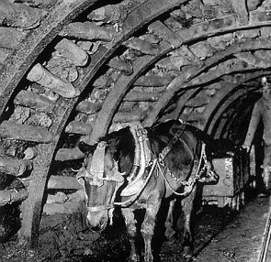
Pit Pony

Slide 3
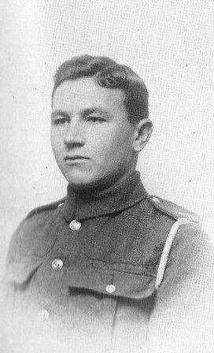

Slide 4
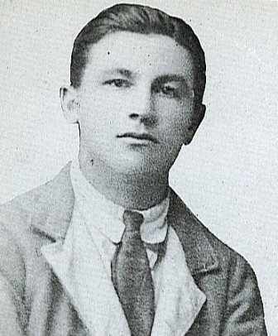

Slide 5
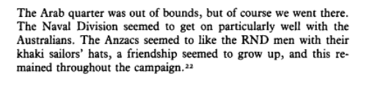
Interview with JM at 93 years old in ‘The Hood Battalion’ by By Leonard Sellers (1993)

Slide 6
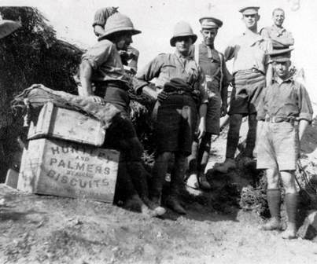
“We have been very comfortable today. Tea was made for us and there was a good supply of Huntley and Palmer's cast-iron biscuits, apricot jam, and a piece of cheese that could not stick the jam any more than we could and repeatedly crawled away.
In such pleasant surroundings, though, it was good to be alive and I feel better already. I feel human again; instead of having to burrow like a mole I can move about in the sunlight.”
Gallipoli As I Saw It, by Joseph Murray (William Kimber: London 1965), p.142-143.

Slide 7
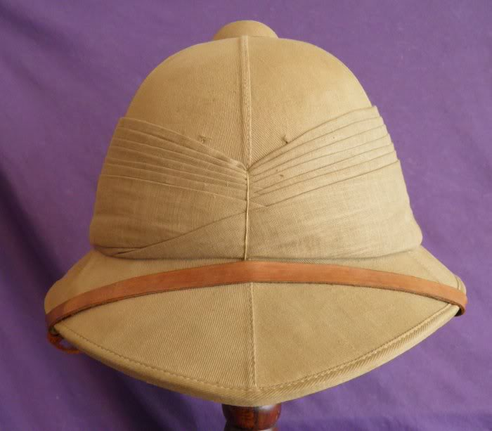
Pith Helmet with purgarees
“Later [February 1915] we were issued with pith helmets which looked awfully naked without their puggarees. A puggaree is a long strip of muslin, about two inches wide, which must be neatly folded round the outside of the helmet. This is much more easily said than done”

Slide 8
Joe Murray came from the mining village of Burnopfield, Durham, in north east England. He left school at 12 to become a greaser and pony driver in the coal mine.
When war broke out, he joined the Royal Navy like his brother Tom. A regular in the Royal Navy, Tom was killed in a naval battle off South America in 1914.
Joe transferred to the Royal Naval Division and landed at Gallipoli in April 1915. After being a front line soldier, he ended up as a tunneller with the Divisional engineers, digging tunnels for various purposes including placing mines underneath the Turkish trenches for use in attacks.
.

Slide 9
Joe describes the Third Battle of Krithia in detail including the charge at the Turkish trenches, 50 yards behind William Denis Browne. While making his way back to the British trenches, he fell in front of a trench full of Turkish soldiers and had to lie there till dusk while one fired his rifle through a loophole just above his head.
He wrote two books on his experiences in Gallipoli and France including Gallipoli As I Saw It (1965) and Call to Arms: From Gallipoli to the Western Front (1980) which he wrote well into his eighties.

Slide 10
References: Ordinary Seaman Joseph Murray
Murray, Joseph (2004) Gallipoli 1915 Cerberus Books
Sellers, Leonard (1995) The Hood Battalion (reprinted Pen and Sword Select 2005)
Gallipoli As I Saw It, by Joseph Murray (William Kimber: London 1965)
http://www.gallipoli-association.org/on-this-day/may-4th

