Slide 1
WHO AM I?

Slide 2


Slide 3
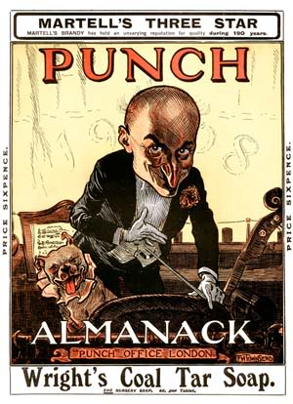

Slide 4
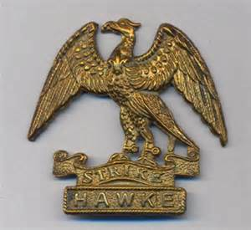

Slide 5
4th June 1915
This is the Fourth of June.
Think not I never dream
The noise of that infernal noon,
The stretchers' endless stream.
The tales of triumph won,
The night that found them lies,
The wounded wailing in the sun,
The dead, the dust, the flies.

Slide 6
On fun in politics
People must not do things for fun.
We are not here for fun.
There is no reference to fun in any Act of Parliament.

Slide 7
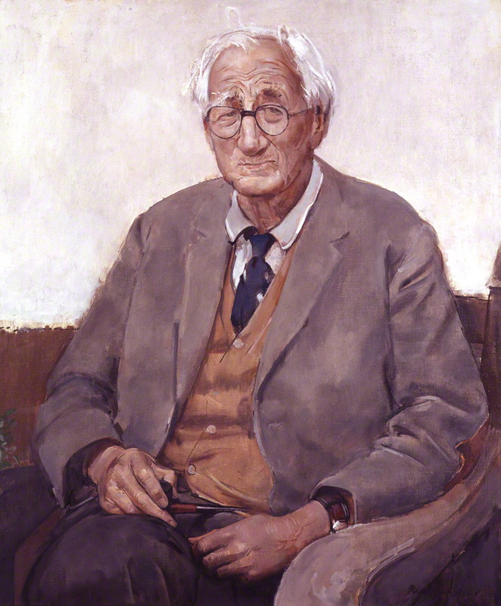

Slide 8
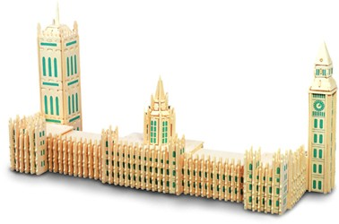

Slide 9
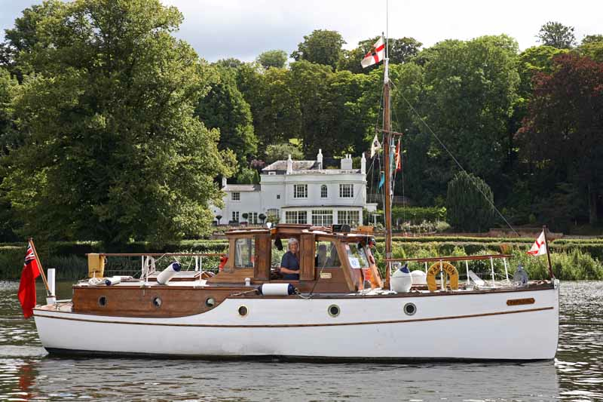

Slide 10
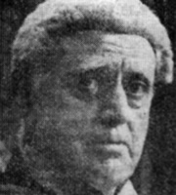
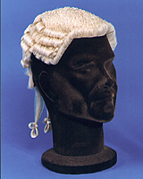

Slide 11
More Uncomon Law
‘This is the… second of two volumes which explore the humorous side of English law, written by a former lawyer and independent MP. Whether writing about the possibility of Brigitte Bardot becoming an MP, or whether a cheque can be written on an egg, the author describes the absurdities of the legal system.’

Slide 12
Summary
From a writer to a soldier, to a law reformer, A. P. Herbert followed many careers. He started writing for the humorous magazine Punch while completing a law degree at Oxford.
Immediately after the outbreak of war in 1914 he joined the Royal Naval Division. His battalion went to Gallipoli in May 1915. On the 4th June 1915 they were in the reserve but soon needed to challenge the fierce Ottoman counter attacks. At Gallipoli Herbert was mentioned in dispatches and wrote many poems. He later drew on his war experiences for a remarkable novel ‘The Secret Battle’ about an officer who was shot in France for cowardice ‘and he was one of the bravest men I ever knew.’ He also wrote WW1’s most famous insulting poem about a general.

Slide 13
Summary 2
As a satirist he was most famous for his “Misleading Cases of the Common Law” series, which commented on the obscure and tangled aspects of the British legal System. ‘Such was his presentation style that though fictional, his works were often mistaken to be real.’
He became a member of parliament for Oxford University in 1935 and was knighted in 1945 for his parliamentary campaigns, backed with satirical writings, against outdated divorce, alcohol licensing and other laws.
Herbert married Gwendolyn Quilter on New Year's Eve 1914, a marriage that lasted until his death in 1971. Gwendolyn lived to the age of 97, dying in 1986. They had four children Crystal, Lavender, Jocelyn Herbert and John.

Slide 14
References: Alan Patrick (AP) Herbert
[1] Herbert, A.P. (1916) Half-Hours at Helles Longmans (full text available at http://www.archive.org/stream/halfhoursathelle00herb/halfhoursathelle00herb_djvu.txt)
[2]Stephen, Martin(1996,2014) Poetry and Myths of the Great War: how poets altered our perceptions of history Pen & Sword Books Military
[3] The Barrister Blog http://timkevan.blogspot.co.uk/2014/12/book-recommendation-more-uncommon-by-ap.html

