Slide 1
WHO AM I?

Slide 2
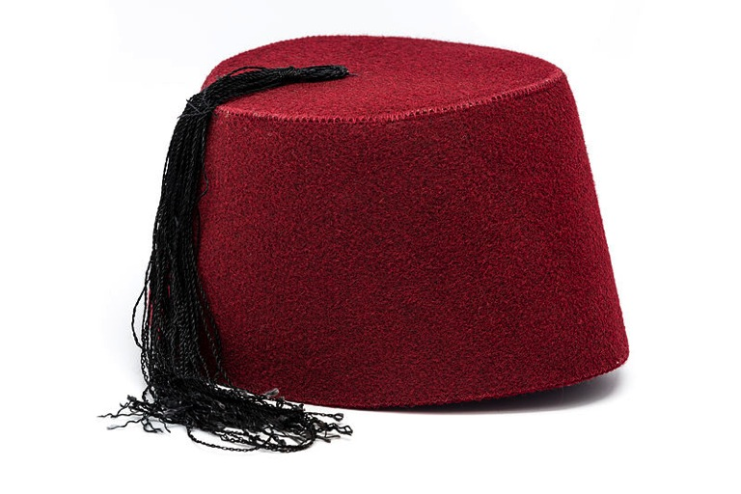
A Fez

Slide 3
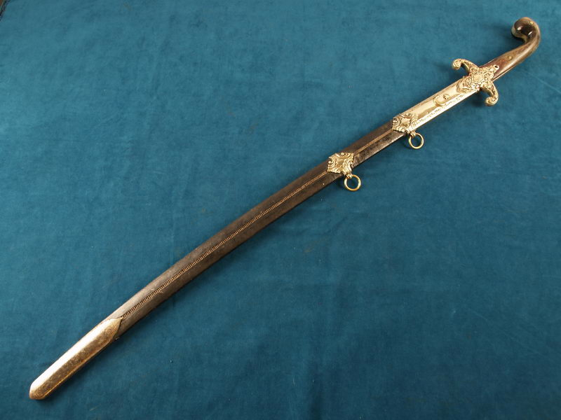

Slide 4
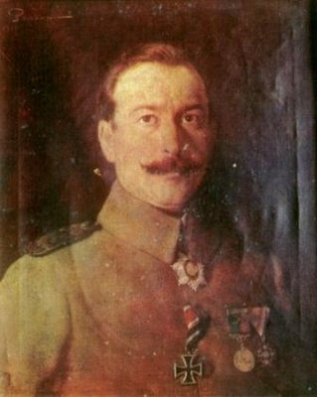

Slide 5
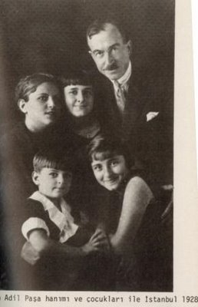

Slide 6
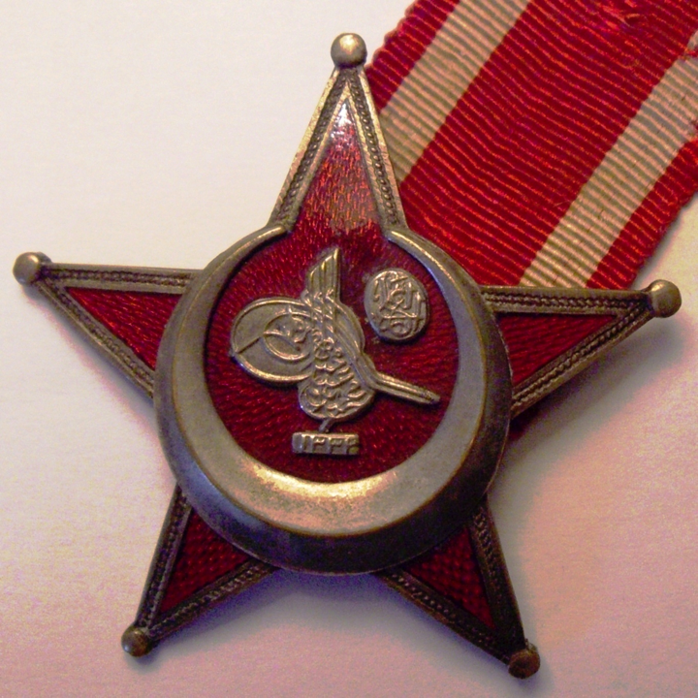

Slide 7
Selahattin Adil was a professional soldier who served in Arabia and the Balkans. He was Ottoman Chief of Staff managing the artillery in the successful defence of Gallipoli Narrows on 18th March 1915, the date on which the failure of the invasion is commemorated in Turkey.
At the Third Battle of Krithia in June 1915, he commanded the 12th Ottoman Division, which defeated the attacks by the British Royal Naval Division and the French army.
After 1918, he joined Mustafa Kemal Ataturk in the War of Independence as commander of the 2nd Army. In October 1923 he became Governor of Istanbul and oversaw the departure of the occupation forces of England and France.
He had a distinguished career in the service of the Turkish Republic and became a member of parliament in 1950. He wrote two memoirs of his life.

Slide 8
References: Selahattin Adil Pasha
Erickson Edward J. (2010) Gallipoli: The Ottoman campaign Pen & Sword Military
T.C. Genelkurmay Harp Tarihi Başkanlığı Yayınları, Türk İstiklâl Harbine Katılan Tümen ve Daha Üst Kademlerdeki Komutanların Biyografileri, Genkurmay Başkanlığı Basımevi, Ankara, 1972, p. 117. (Turkish)
http://harunaron.blogspot.co.uk Arun Harun is a descendant of Selahattin Adil Pasha. The site contains some excellent photographs.

