Slide 1
WHO AM I?

Slide 2


Slide 3
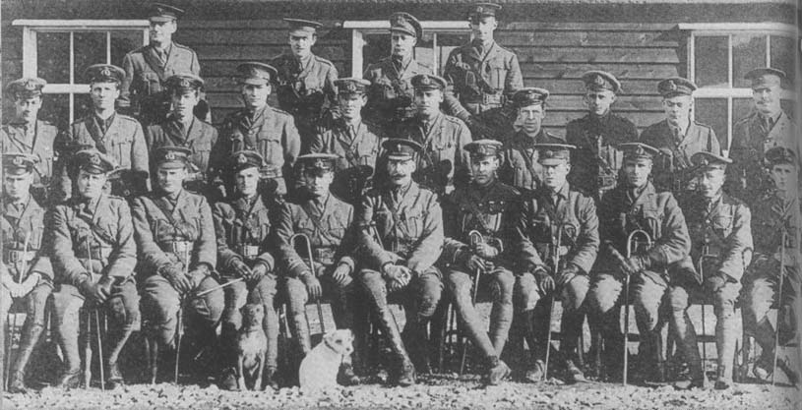
The Hood Battalion: Royal Naval Division

Slide 4
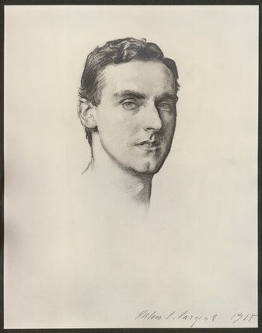

Slide 5
"I got in an hour's sleep before lunch and another hour before tea. Before dinner I played Scarlatti's C Minor sonata and Chopin's B Minor Ballade. We all expect to be in action tomorrow.(1)”

Slide 6
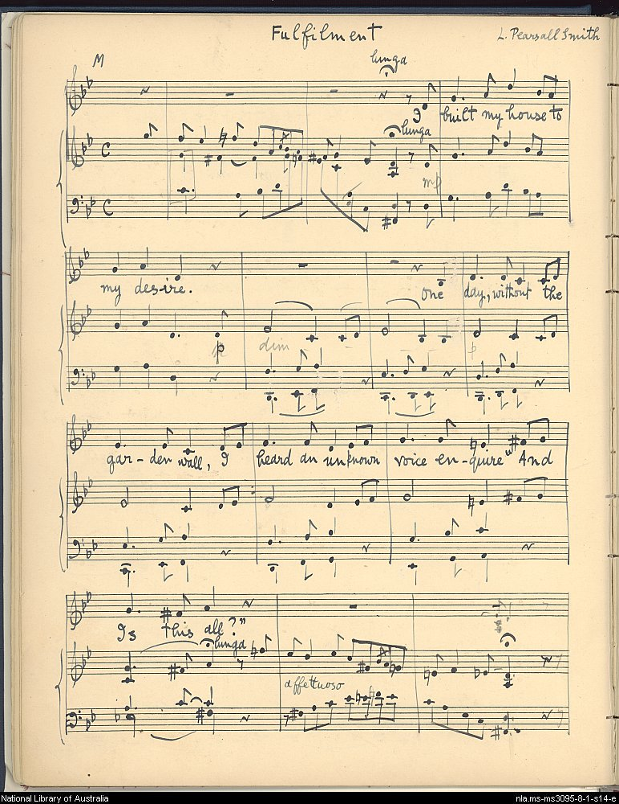

Slide 7
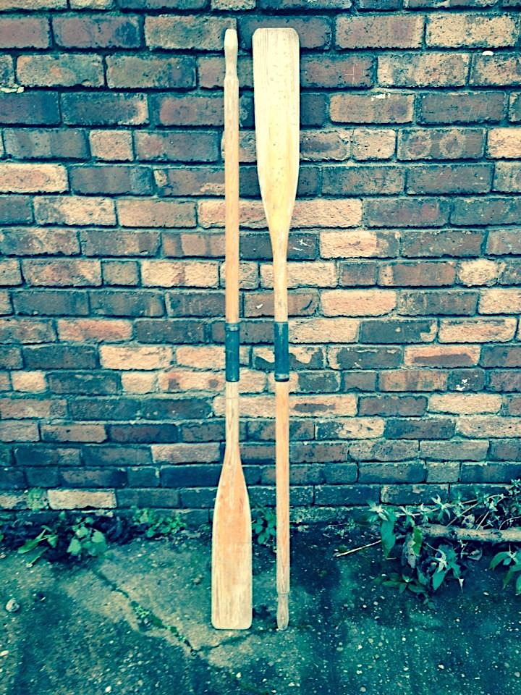

Slide 8
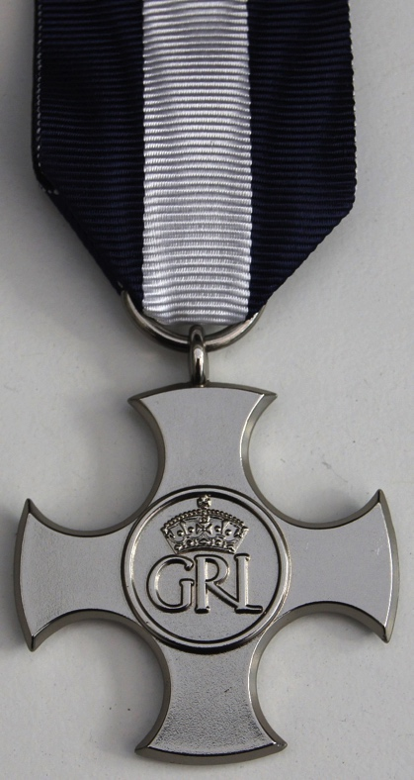
Distinguished Service Cross

Slide 9
‘It was practically completed before we reached Sydney. He called it Serenade, consisting of five movements. The first – Prelude – was written in the Indian Ocean; the second – Idyll – off the coast of West Australia; the third – Minuet – in the Great Australian Bight; the fourth – Air and Variations – off the coast of Victoria; and the fifth – Jig – off the coast of New South Wales.
The work is of transcendental beauty and undoubtedly a classic. Later, in Sydney, I had the rare pleasure of playing this composition conducted by the composer, who was none other than FS Kelly, a brilliant Australian pianist, perfectly modest about his fine musicianship and a composer who would probably have made a great reputation, but, alas!, he was killed in action in France. [2]’

Slide 10
Summary: F.S.Kelly
Australian born Frederick Septimus ‘Cleg’ Kelly first achieved distinction in rowing whilst at university at Oxford and eventually in the London Olympics.
Pursuing his musical career after Oxford, he studied in Frankfurt and gave recitals in Europe and Australia while developing his skills as a composer.
Kelly served with his friends, the poet Rupert Brooke and the composer William Denis Browne, in the Royal Naval Division in 1914 before joining the campaign in Gallipoli.

Slide 11
Summary: F.S.Kelly
Brooke’s death en route moved Kelly deeply; he wrote his best known composition Elegy for String Orchestra: In Memoriam Rupert Brooke during the campaign. He was wounded at Gallipoli and won the Distinguished Service Cross.
He was killed fighting at the Somme in 1916. Jelly D’Aranyi, a well-known Hungarian violinist, played the sonata he wrote for her at his memorial service.

Slide 12
References: Frederick Septimus (Cleg) Kelly
Therese Radic ed. (2004) Race Against Time: The diaries of FS Kelly National Library of Australia
John Lemmone with EW Garside, 'The memoirs of John Lemmone – Flute Virtuoso’ in The Flutist 1926/1927
http://www.classicfm.com/discover/music/remembrance-great-composers/frederick-septimus-kelly/

