Slide 1
WHO AM I?

Slide 2
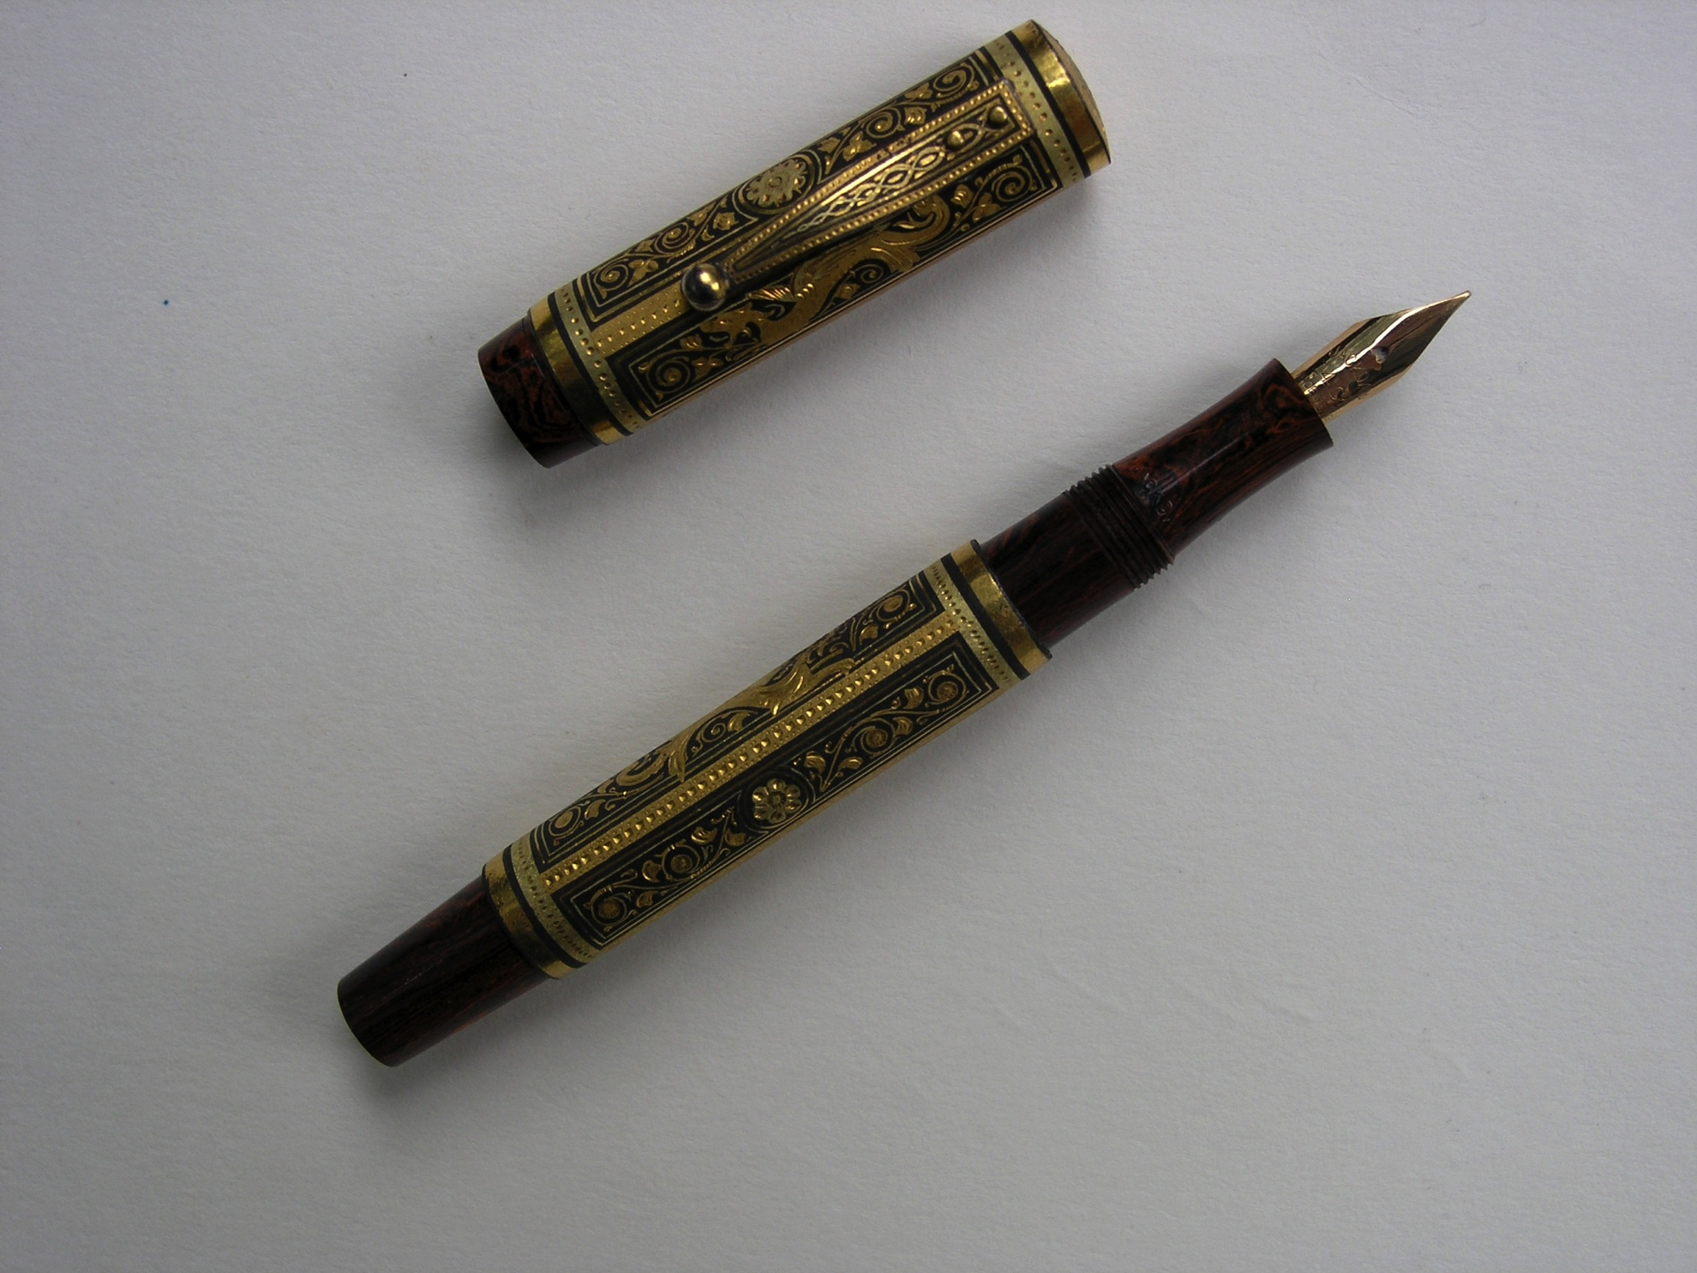

Slide 3
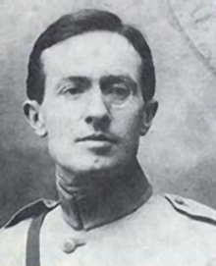

Slide 4
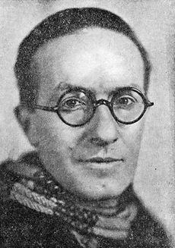

Slide 5
Carnet des Dardanelles - A Dardanelles Notebook
Jean Giraudoux, Extracts April-June 1915
25th April 1915
In barracks in Salon-en-Provence, waiting to go to Gallipoli . The Commandant Berthon has been decorated: he has the eyes of an elephant, determined and heavy.
20th May 1915
My first meal ashore. I share a tent with Juéry and Garrigue on the beach [at Morto Bay]. Visit Roux and that clever man Boissonas. Back to the beach. We are under fire non stop. Dinner with a little wine and anchovies.
We sleep near Garrigue on sleeping bags two metres from the beach. Some Turkish dogs visit us in the night. Juéry teaches me how to talk to them.
27th May 2015
We move camp. We have just installed ourselves at the foot of the division. We have another view, a view facing the enemy. We play manille, sheltered from the gunfire.
9th June 2015
News: we will go into the attack tomorrow at noon.
It is perhaps a bit premature: three hundred metres into the barbed wire. At last!
Write to mother and Suzanne. I prepare the men for the idea of the attack. The artillery tries to shoot accurately. Accident. A long afternoon.

Slide 6
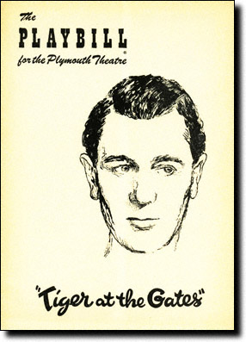
Tiger at the gates (1935) by Jean Giraudoux
‘As soon as war is declared it will be impossible to hold the poets back. Rhyme is still the most effective drum.’

Slide 7
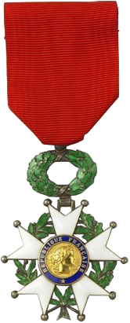
Ribbon legion d’honneur

Slide 8
Jean Giraudoux
Jean Giraudoux was a French novelist, diplomat and playwright. He is considered among the most important French dramatists of the period between World War I and World War II. He first achieved literary success through his novels whilst working in the diplomatic service for the Ministry of Foreign Affairs after he graduated in 1910.
With the outbreak of World War I, he served with distinction and in 1915 became the first writer ever to be awarded the wartime Legion of Honour. His regiment arrived in Gallipoli in May 1915. He was in the French reserve trenches on the 4th June 1915 but back in the front line a few days later; he was wounded, but refused to leave leave his post until wounded again several hours later.

Slide 9
Jean Giraudoux (2)
Surviving the war, he gained international renown through his plays. Whilst continuing his career in the diplomatic service. He became well known in the English-speaking world largely because of award-winning adaptations of his plays such as Tiger at the Gates also known as The Trojan War Will Not Take Place.
Within the setting of the story of the Trojan War, Giraudoux criticises diplomacy and actions of the national leaders who brought about World War I.
At the beginning of World War 2, he was French High Commissioner for Information, but later virtually withdrew from public life as it became intolerable after the German invasion. He died after a short illness on the 31st January 1944.

Slide 10
References
http://www.playbillvault.com/Show/Detail/Cover/9619/9151/Tiger-at-the-Gates
http://www.millsaps.edu/_resources/author_files/program_tatg57-58.pdf
http://www.ibdb.com/person.php?id=6679
http://en.wikipedia.org/wiki/Jean_Giraudoux
http://www.britannica.com/EBchecked/topic/234192/Jean-Giraudoux

