Slide 1
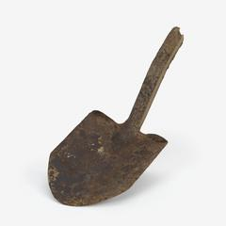
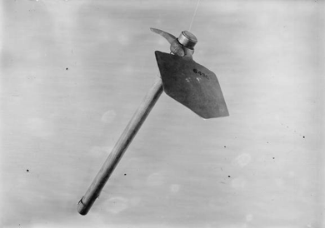
DIGGING - A SONG OF THE SPADE
Alan Patrick Herbert

Slide 2
Digging: a Song of the Spade
Alan Herbert wrote this poem at Gallipoli to describe digging trenches at night
The soldiers dug on dark nights, before the moon came up, so that they would not be seen and shot at by the enemy
The ‘speaker’ in the poem, like many at Gallipoli, has worked peacetime as a miner on Tyneside in north-east England.
Herbert wrote the poem in the style of Thomas Hood’s ‘Song of the Shirt‘. Hood wrote the poem as a protest about working conditions in factories
‘strays’ in the first verse are stray artillery shells
the trenches were often given the name of a street or road: Mercer Street was the name of a trench

Slide 3
A Song of the Spade
‘I sometimes think this war should go down in history as the War of Spades…..I once heard a woman name forty six things she could do with a hairpin. It was a poor soldier that couldn’t do sixty four with a spade after a month in Gallipoli.’
Captain Albert Mure, Royal Scots, 29th Division

Slide 4


Slide 5

Digging: a Song of the Spade
With heavy sleepless eyes,
With faces starved and drawn,
Some soldiers stood in a dreary ditch
And dug before the dawn:
Dig-dig-dig,
And around the barricade,
While the bullfrogs croaked in the gully-bed
And the ‘strays’ went whispering overhead
They sang the Song of the Spade.

Slide 6
Digging: a Song of the Spade (edited)
Dig-dig-dig,
Ever a job to do.
The mules must walk in a covered track.
‘The officer’ needs a nice new shack.
The parapet here is much too thin
The general’s roof is falling in
And somebody wants a hundred men
Up the gully tonight at ten
And a hundred more at two.

Slide 7
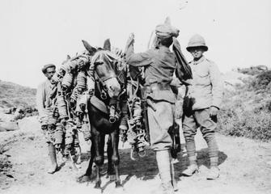
Notes:
Loading a mule at Gallipoli in 1915
Photograph by Major A. Wadman
IWM Q 61514

Slide 8
Digging: a Song of the Spade (edited)
Dig-dig-dig,
And underneath the stones,
Dig-dig-dig,
You find a Frenchman’s bones.
Pick and shovel and sand,
Shovel and sand and pick,
Cover him there for a little yet,
Man must sleep where his tomb is set.
Quick, lad, cover him quick.

Slide 9
Digging: a Song of the Spade (edited)
Dig-dig-dig,
Dig in the dark out there.
Less noise somebody! God what’s that?
Only the feet of a frightened rat.
Dig, and be done before the moon.
Dig, for the Turk will spot you soon!
Lie down, you fools, a flare!

Slide 10
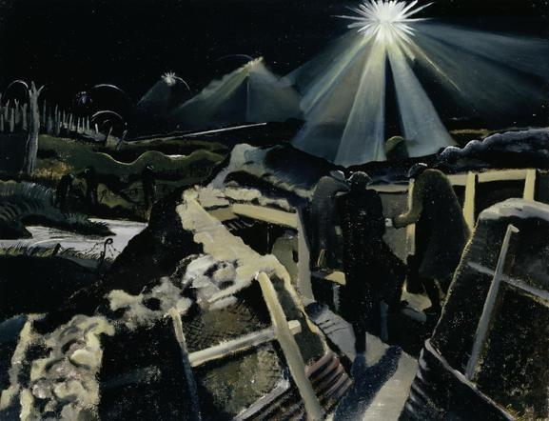
Notes:
© IWM (Art.IWM ART 1145) by Paul Nash (in France, not Gallipoli: there were no ‘tin helmets’ at Gallipoli

Slide 11
Digging: a Song of the Spade (edited)
Dig-dig-dig,
One of the section dead.
Dig-dig-dig,
For we must make his bed:
Pick and shovel and sand,
Shovel and sand and pick,
Oh God, to think it was for this,
I learned the pitman’s trick.

Slide 12
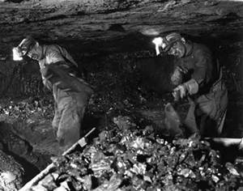

Slide 13
Digging: a Song of the Spade
With heavy sleepless eyes,
With faces starved and drawn,
Some soldiers stood in a dreary ditch
And dug before the dawn:
Dig-dig-dig,
And around the the barricade,
While the bullfrogs croaked in the gully-bed
And the ‘strays’ went whispering overhead
They sang the Song of the Spade.

Slide 14
Reference
Mure, Albert (1919) With the Incomparable 29th London: W&R Chambers

