Slide 1
Interpreting photographs
Photographs can tell us about the war.
These are primary evidence.
Look at the pictures and say what you think is happening.
Part of the Gallipoli Music Memorial Resources
Created by Widgit Software www.widgit.com
Photographs from the Imperial War Museum

Slide 2
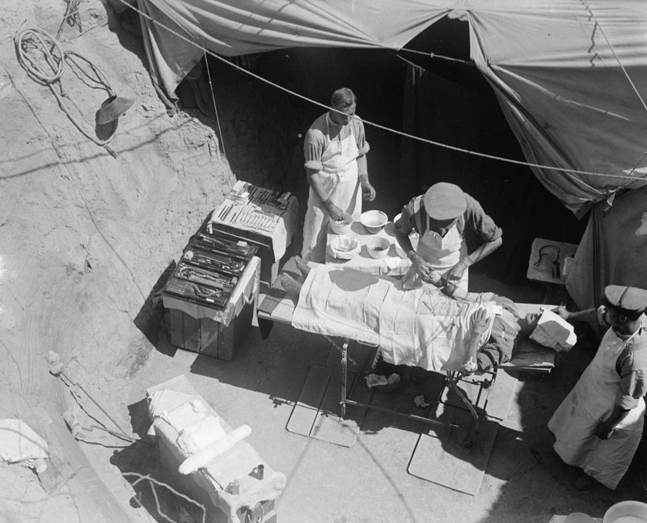
Photograph © IWM Q13316
A field hospital
What kinds of injuries were treated in tent hospitals?
Why was it difficult for the doctors?

Slide 3
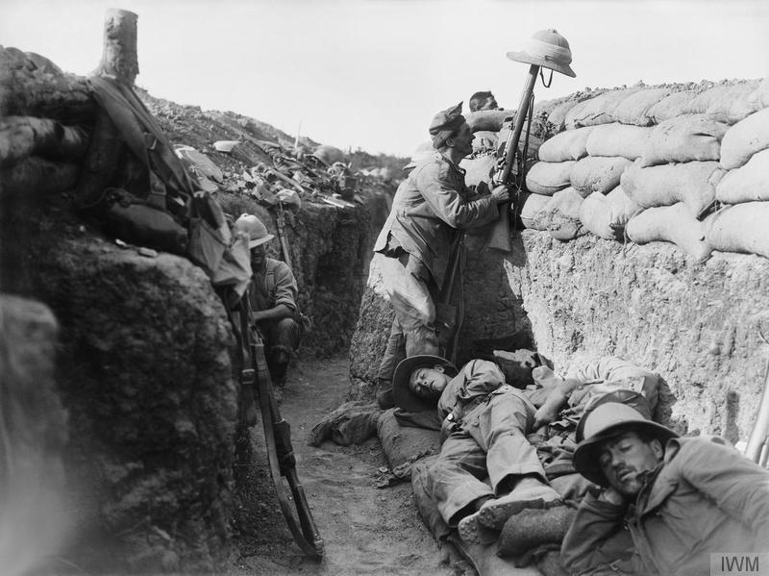
Photograph © IWM Q 13447
In the trenches
Why is this soldier holding a helmet on top of his rifle?
Where did the soldiers sleep?

Slide 4
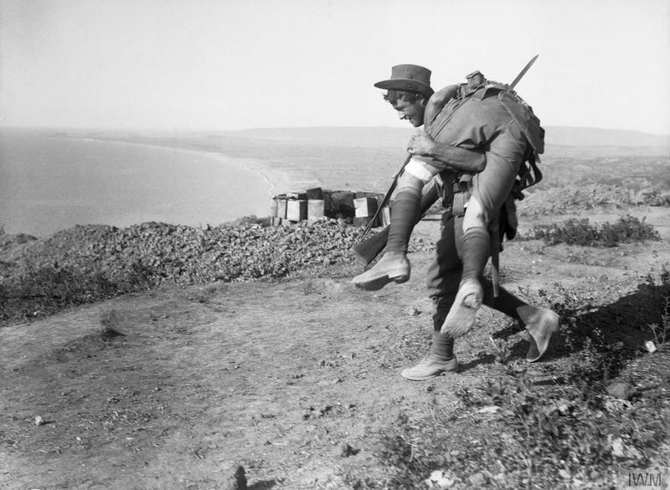
Photograph © IWM Q 13622
Saving a friend
What happened when a soldier was injured?
Was it safe to rescue wounded soldiers?

Slide 5
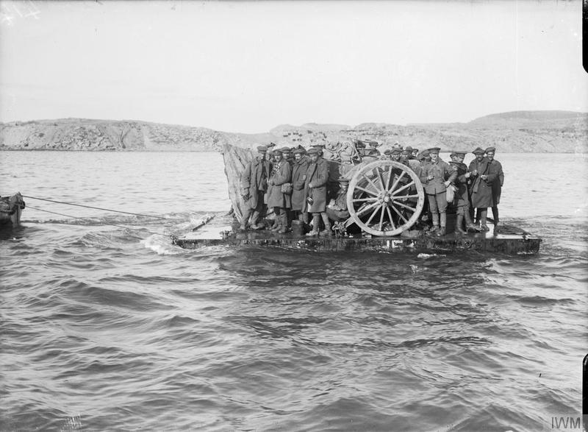
Photograph © IWM Q 13637
Landing heavy equipment
How did they bring artillery from the ships to the beaches?
What else did they need to bring from the ships.

Slide 6
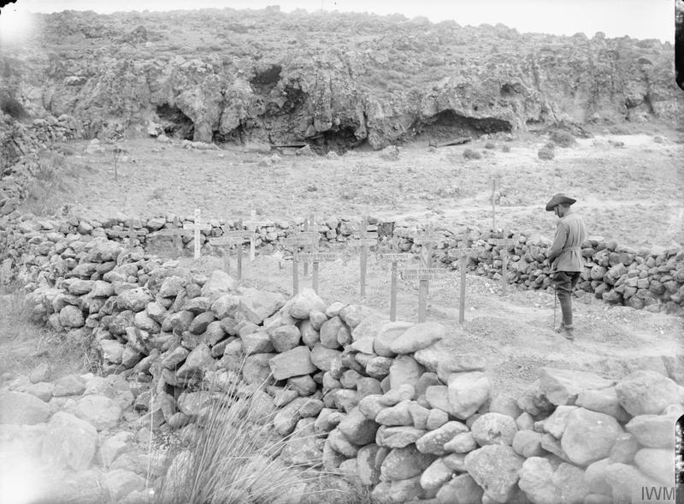
Photograph © IWM Q 13438
A war cemetery
Why is this soldier standing in the cemetery?
How did families at home know when a soldier had died?

Slide 7
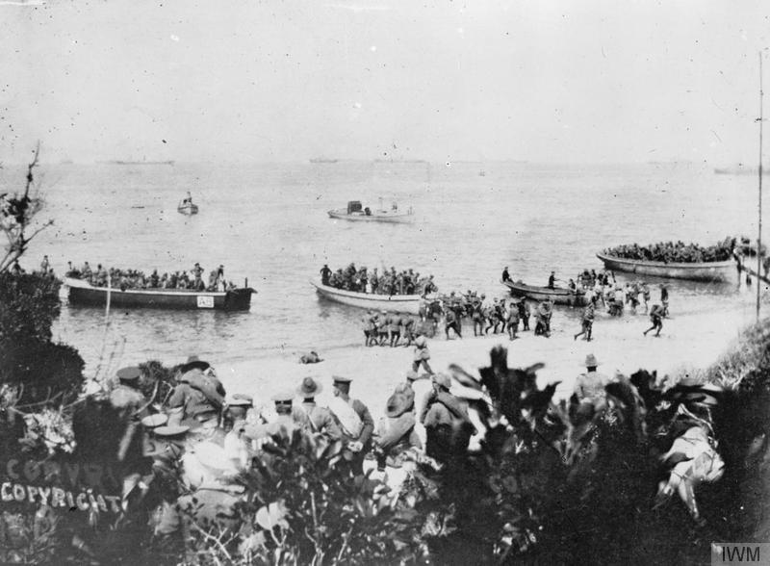
Photograph © IWM Q 112876
Landing on the beaches
How do you think the soldiers felt as they landed on the beaches?
What did the soldiers do as soon as they landed?

Slide 8
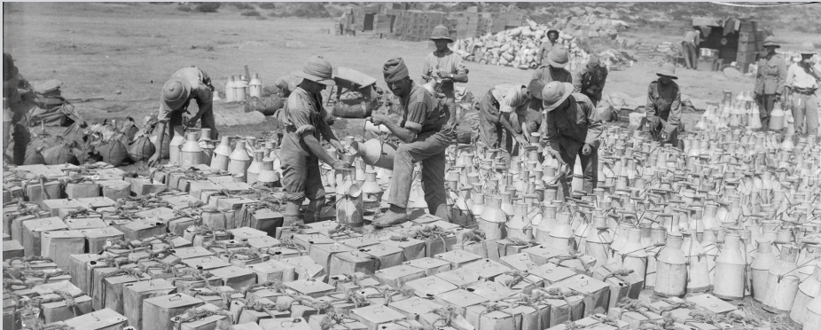
Photograph © IWM Q 13448
Food and water distribution
Why did they need to have all these water containers.
What work did soldiers do when they weren't fighting?

Slide 9
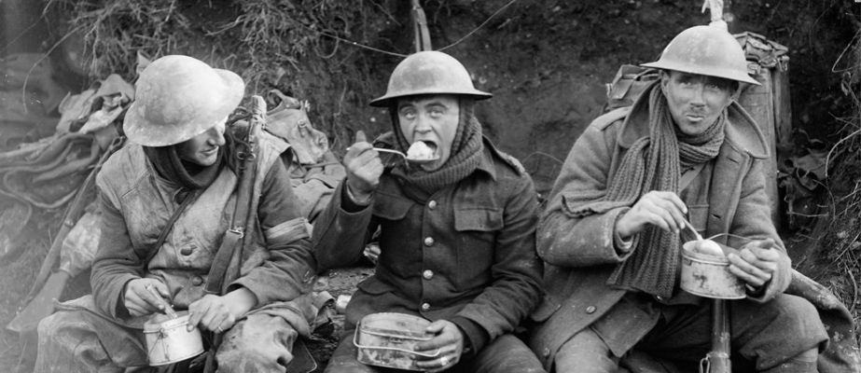
Photograph © IWM Q 1580
Eating in the trenches
What food might soldiers eat in the trenches.
Where was the food cooked?

Slide 10
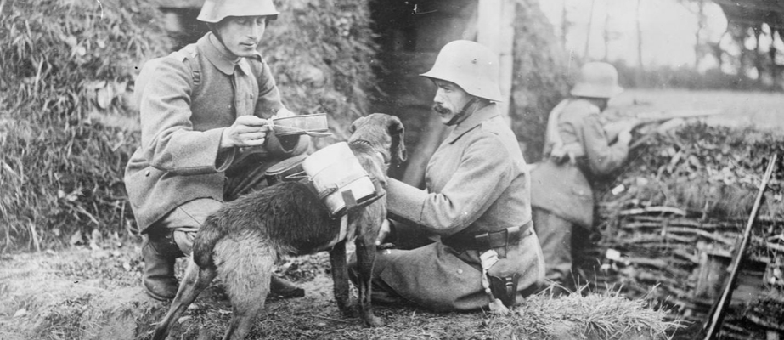
Photograph © IWM Q 23700
A dog bringing food to soldiers in WW1
Why did dogs bring the food to the soldiers?
What happened if the dog didn't reach the soldiers?

Slide 11
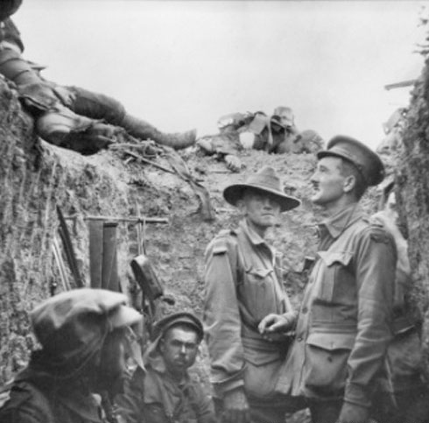
Photograph © AWM A02025
A commander and his men in a trench.
Why is somebody lying on top of the trench?
Why has nobody brought the man down for burial?

Slide 12
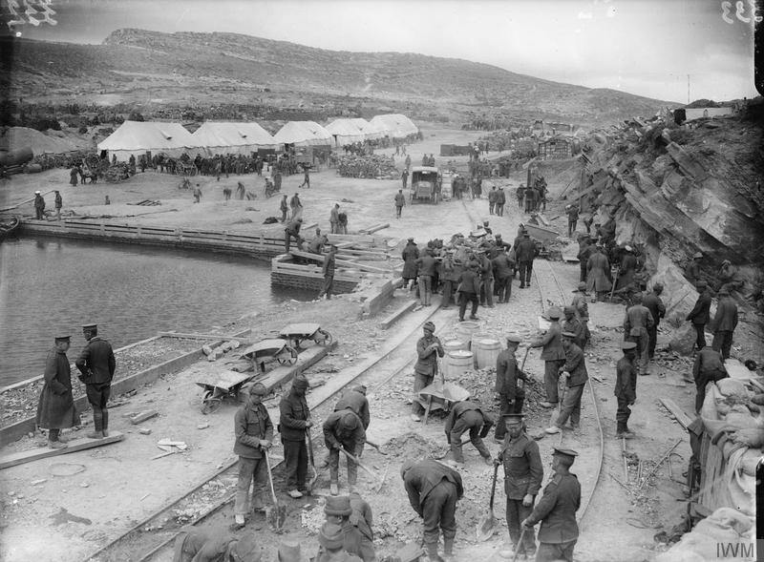
Photograph © IWM Q 13552
What is happening in this picture?
What can you find out from it?

Slide 13
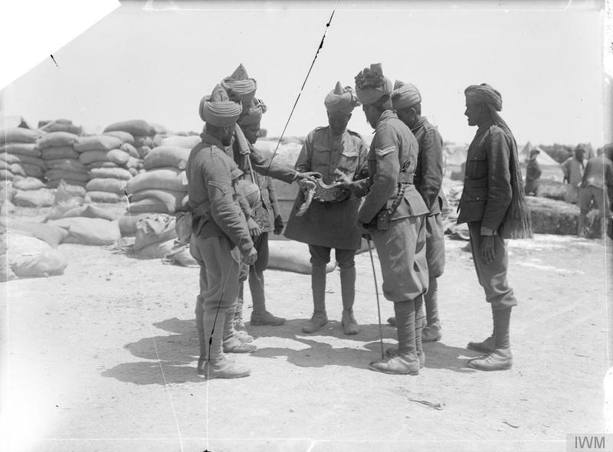
Photograph © IWM 13372
What is happening in this picture?
What can you find out from it?

Slide 14
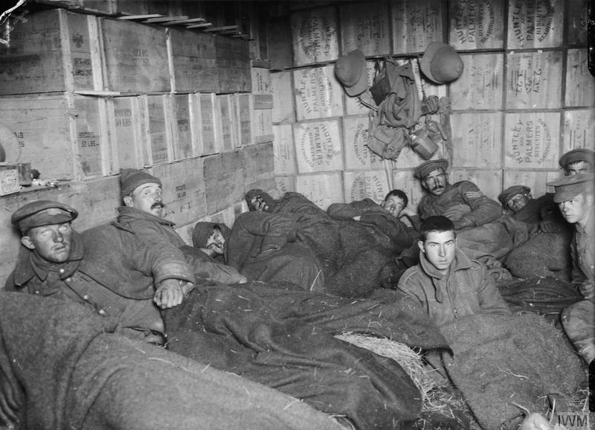
Photograph © IWM Q 13644
What is happening in this picture?
What can you find out from it?

