Slide 1


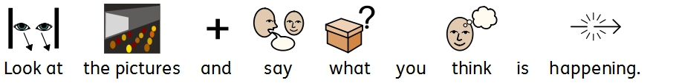
Part of the Gallipoli Music Memorial Resources
Widgit Symbols © Widgit Software 2002-2015
Photographs from the Imperial War museum

Slide 2
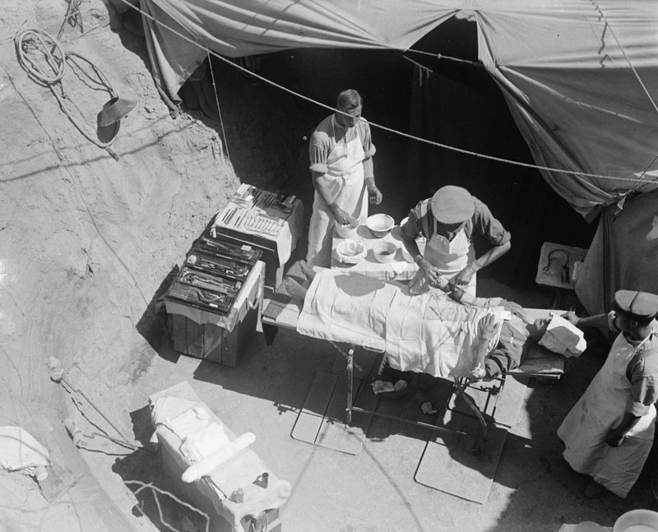



Photograph © IWM Q13316

Slide 3
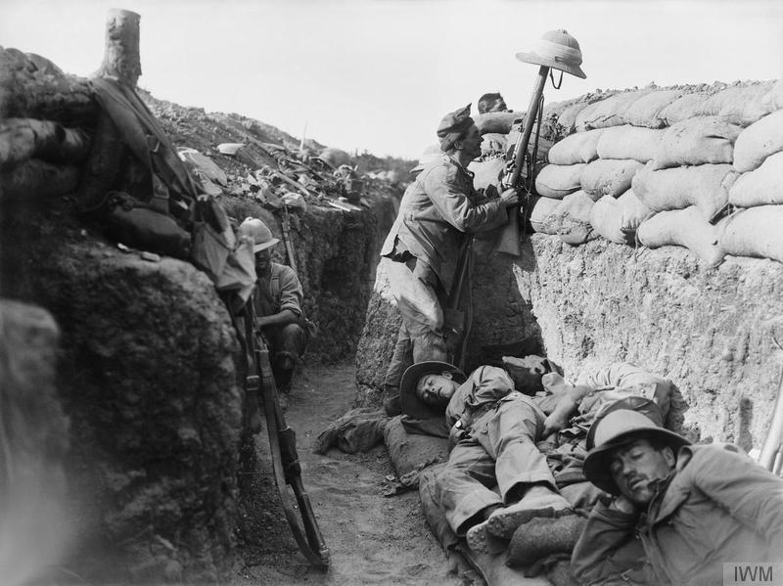



Photograph © IWM Q 13447

Slide 4
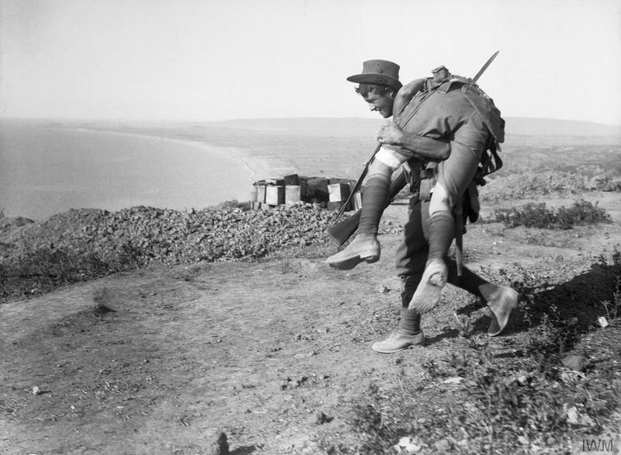



Photograph © IWM Q 13622

Slide 5
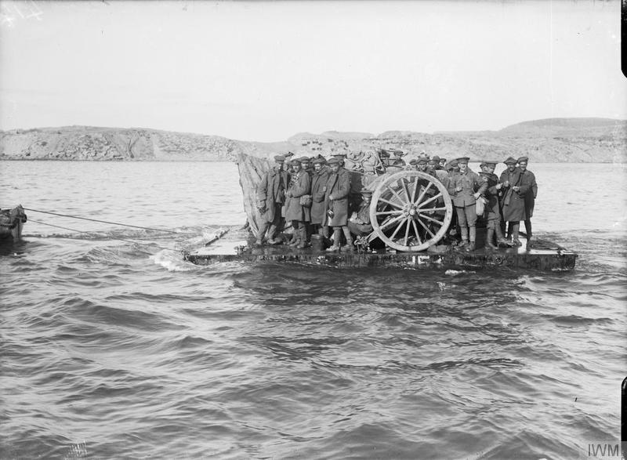



Photograph © IWM Q 13637

Slide 6
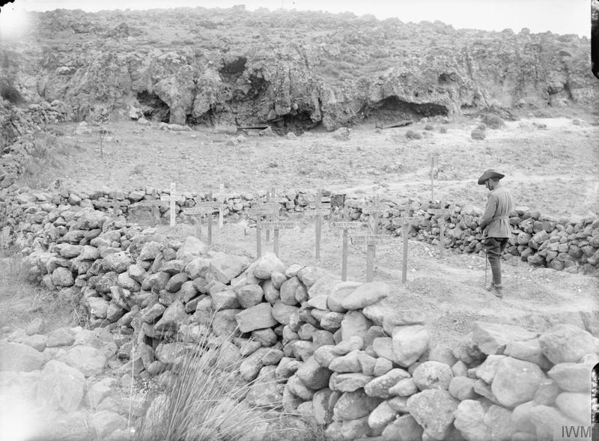



Photograph © IWM Q 13438

Slide 7
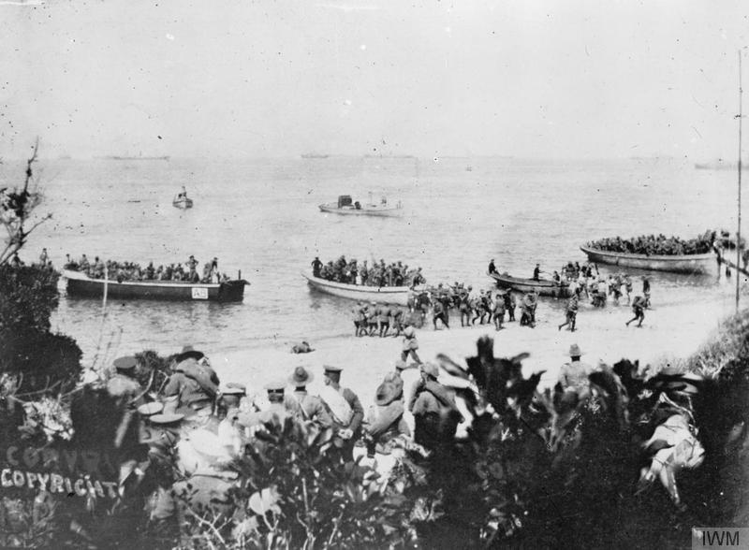



Photograph © IWM Q 112876

Slide 8
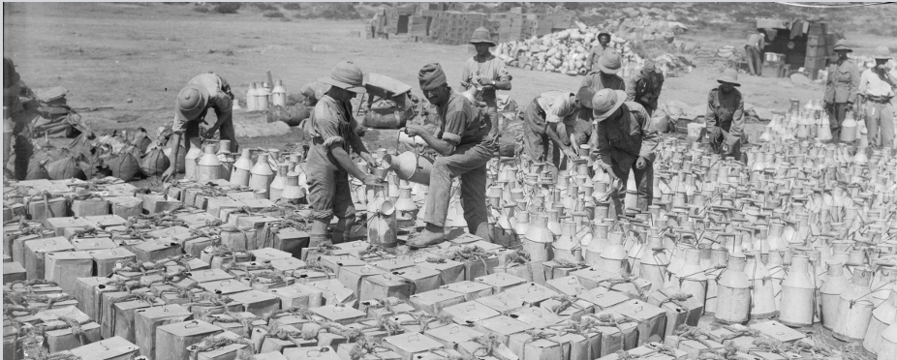



Photograph © IWM Q 13448

Slide 9
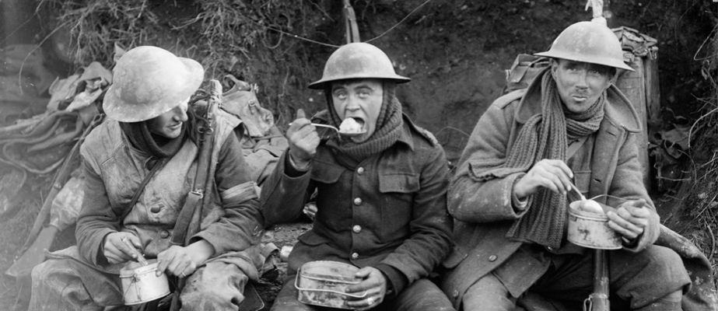



Photograph © IWM Q 1580

Slide 10
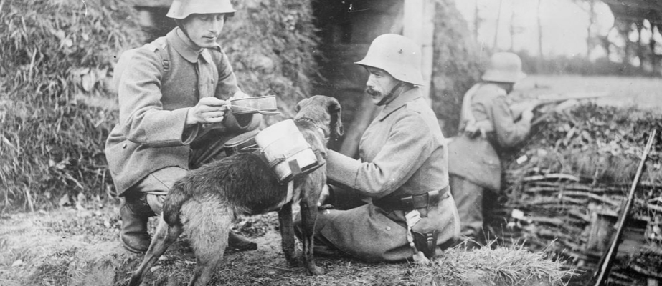



Photograph © IWM Q 23700

Slide 11
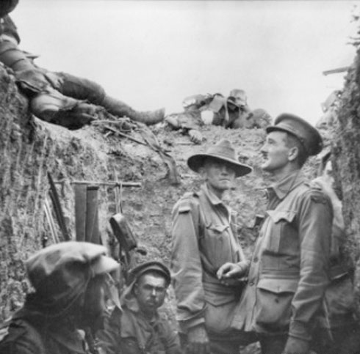



Photograph © AWM A02025

Slide 12
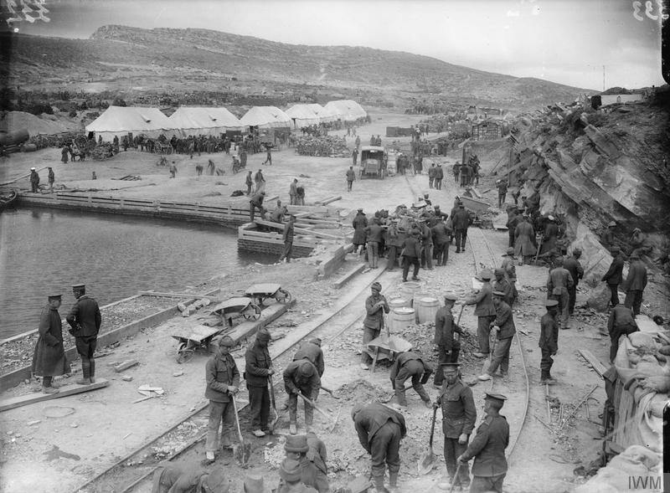


Photograph © IWM Q 13552

Slide 13
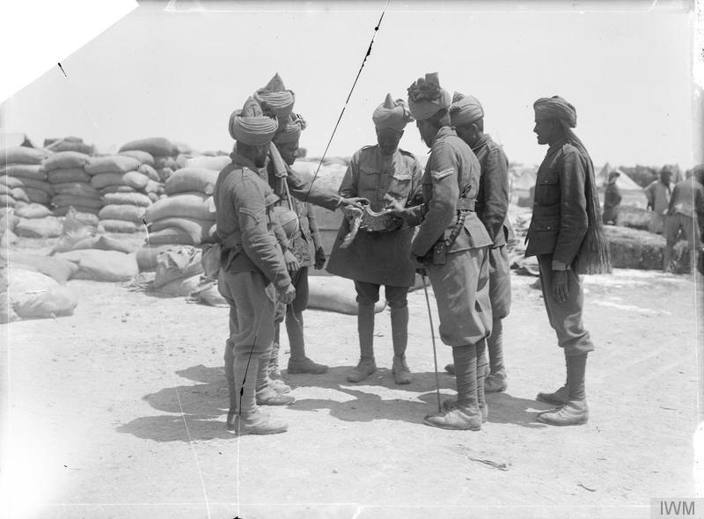
Photograph © IWM 13372

Slide 14
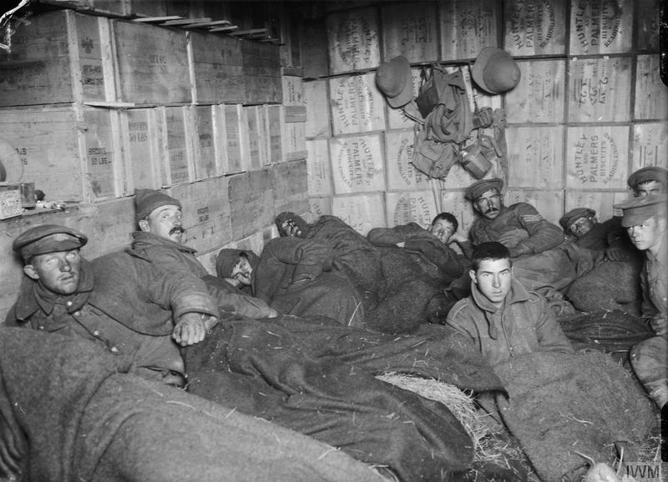
Photograph © IWM Q 13644

