Slide 1
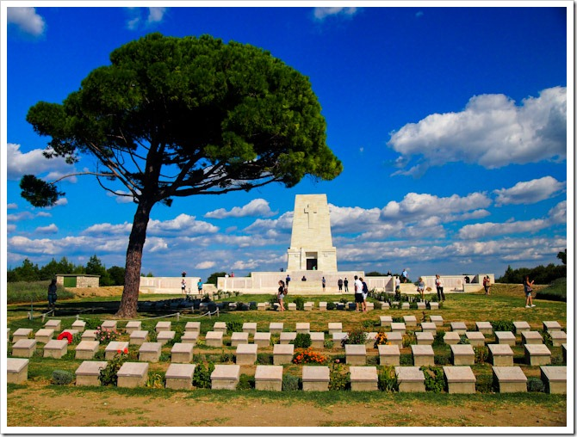
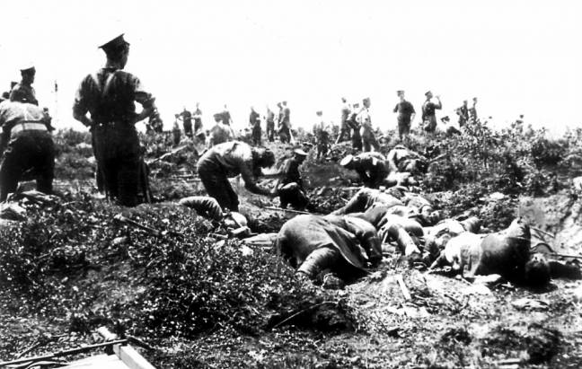
Why was the Gallipoli campaign a failure?

Slide 2
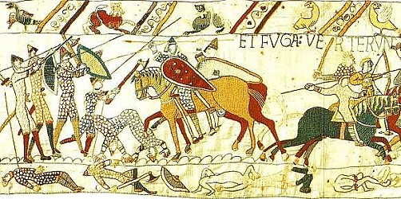
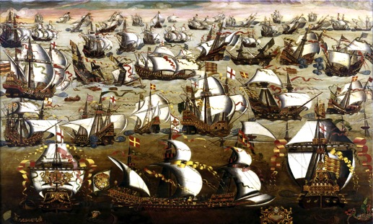
Task 1:What were the key reasons for the:
the victory of the Normans at the Battle of Hastings, 1066?
the victory of the English over the Spanish Armada, 1588?

Slide 3
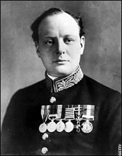
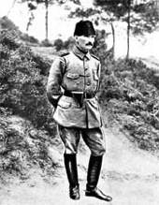
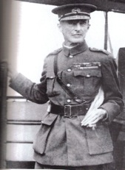
Learning outcomes
All to identify the key reasons why the Gallipoli campaign failed
Most to explain the reasons, using a range of evidence
Some to evaluate the causes, linking them to make a judgement.

Slide 4
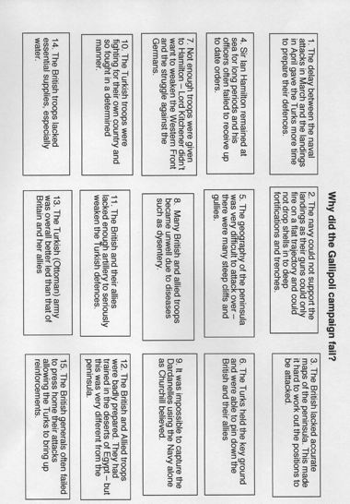
Task 2: sort the statements
Planning and preparations
Leadership during the battles
Turkish advantages and morale/confidence

Slide 5
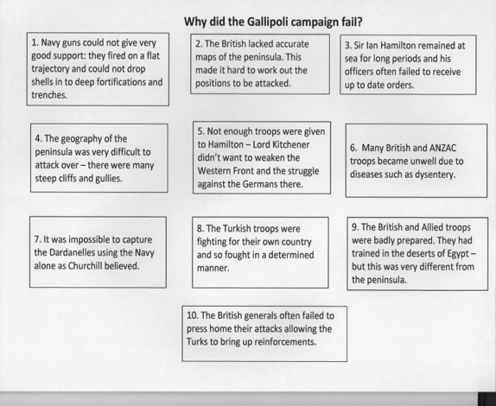
Task 2: sort the statements
Planning and preparations
Leadership during the battles
Turkish advantages and morale/confidence

Slide 6
Task 3: Why was the Gallipoli campaign a failure?
Introduction – identify each key point you wish to make in your answer
Use point/evidence/explanation (PEE) to develop your answer
Start paragraph 2 with a key point, i.e. The first reason why the Gallipoli campaign failed was…
Support this then with key evidence and explanation
Use key connectives (i.e. ‘Furthermore. . .’ / As a result. . . / This was significant because. . . etc)
End with a developed conclusion which gives your judgement

Slide 7
Success criteria
Satisfactory work – you identify some of the reasons why the campaign failed but your answer fails to explain the evidence
Good work: - you identify all of the reasons why the plan failed and offer developed explanation of some of the evidence
Very good work: you fully explain the reasons using a wide degree of evidence and include a conclusion which identifies the key reasons
Exceptional work: your answer is well-developed making use of an extensive range of evidence which is then well explained using key historical terminology before reaching a sustained judgement which links the factors

Slide 8
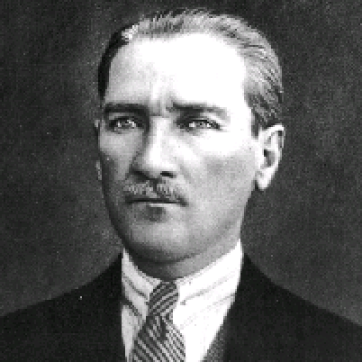
The words of Kemal Ataturk, 1934
“Those heroes that shed their blood and lost their lives... You are now lying in the soil of a friendly country. Therefore rest in peace. There is no difference between the Johnnies and the Mehmets to us where they lie side by side now here in this country of ours... you, the mothers, who sent their sons from faraway countries wipe away your tears; your sons are now lying in our bosom and are in peace. After having lost their lives on this land they have become our sons as well”

